Slide 1
Python Package for Industrial Time Series Analysis

Slide 2
Data loading and resampling
Data in JSON format, input with timestamp and value
Example: {'timestamp': ..., 'value': ...}
Timestamps are not evenly spaced
Need to resample the data to regular intervals (e.g., 1 second)
Resampling introduces missing values,
Gaps are filled using the nearest known values
(interpolation method)

Slide 3
State detection and outliers removal
We use median filtering to detect states to separateProduction and Standby
Median filtering helps reduce outlier influence
We get masks of each states to localize them easely
Why This Approach?
Low computational cost
Fast and simple implementation
No machine learning or training data required

Slide 4
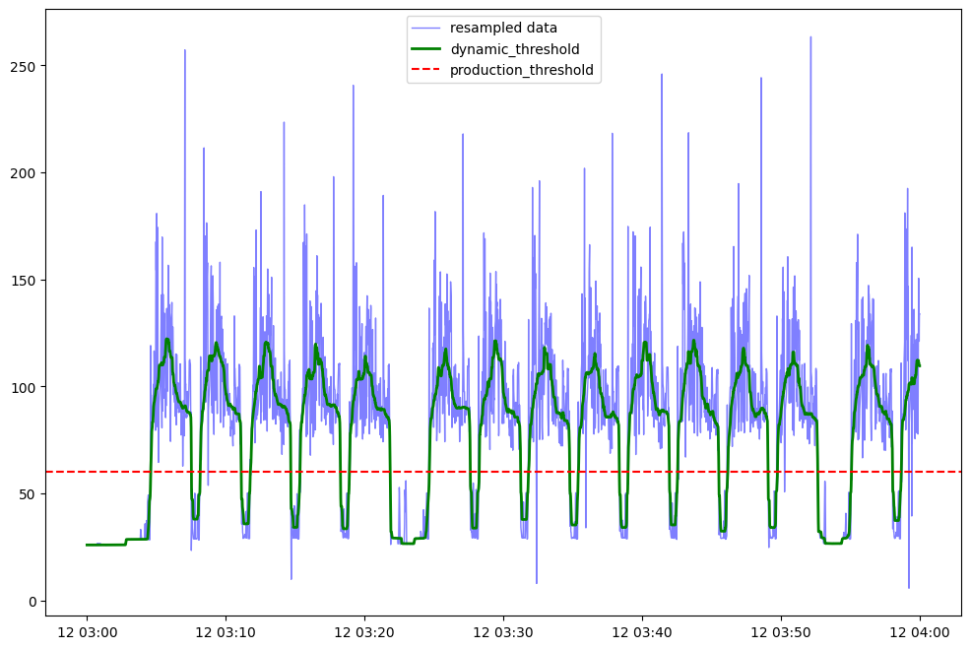
State detection principle
We are in production state If the median (in green) is above the production theshold else we are in standby

Slide 5
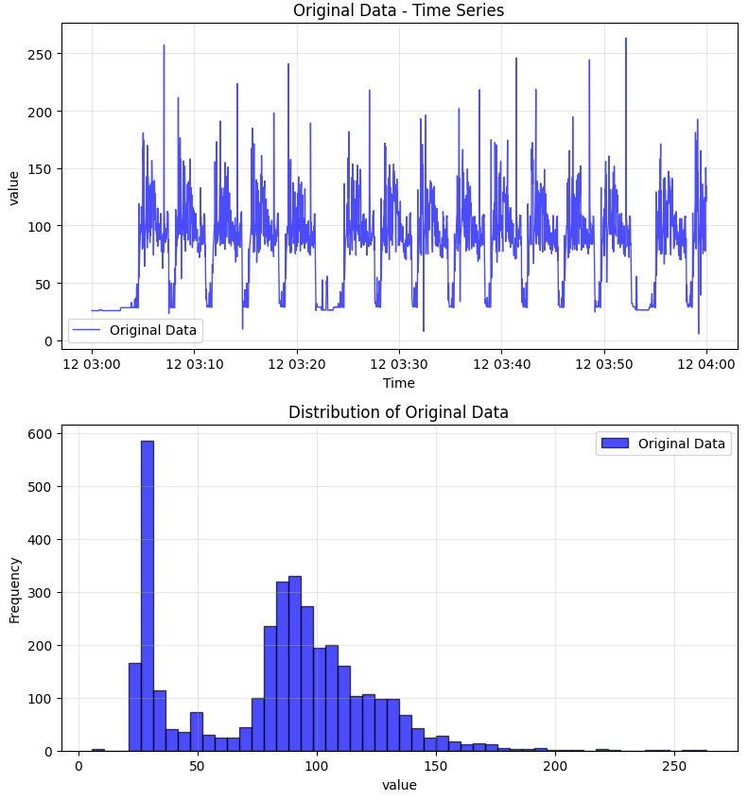
Before outlier removal

Slide 6
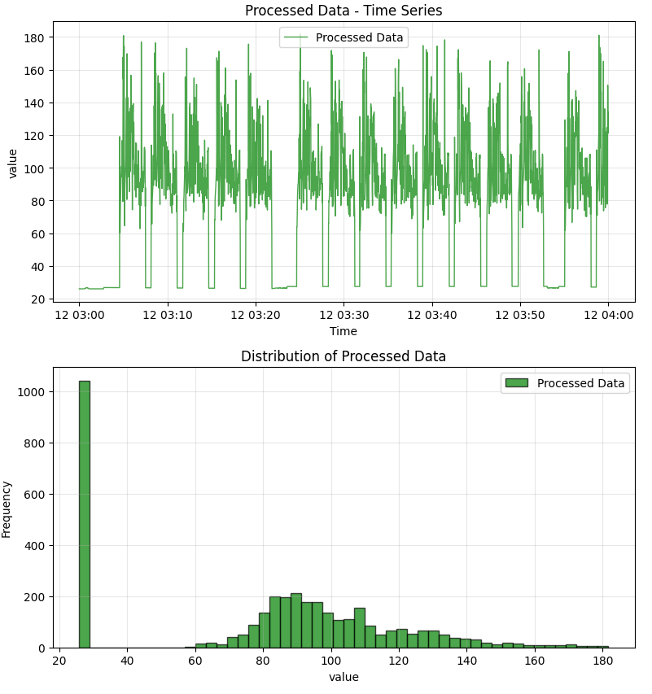
After outlier removal

Slide 7
Focus on Production States
After state detection, extract production segments
We take the generated production mask from state detection
Production_mask = {false, false,true,true,true,false}
Productions states are where the mask is true

Slide 8
Segmentation
We can then separate all production states in to segments ,based on the mask
We get all the information related to the segment and put it into a data object (database to be implemented) for later manipulation in quality analyzer

Slide 9
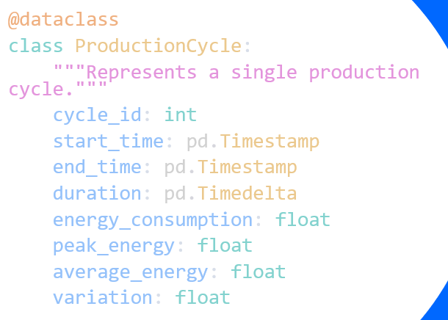
Cycle Segmenter
From the segmenter we get a list of all the cycles each in a data objet

Slide 10
Cycle Comparison (rule based)
Compare each production cycle to a standard one (by duration,energy consumption and , energy variation )
Identify the most deviating cycles
Assigning grade to the number of deviating pattern
A : no issue
B : 1 issues
C : 2 issues
D : 3 issues

Slide 11
Conclusion
Lightweight and interpretable solution for industrial data
Works in real-time environments
ML anomaly classification can be implemented (need more examples of cycle)

